Slide 1
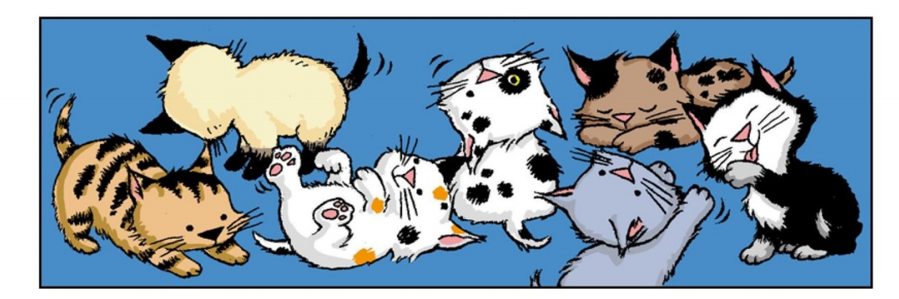
Carlos Count Kittens

Slide 2
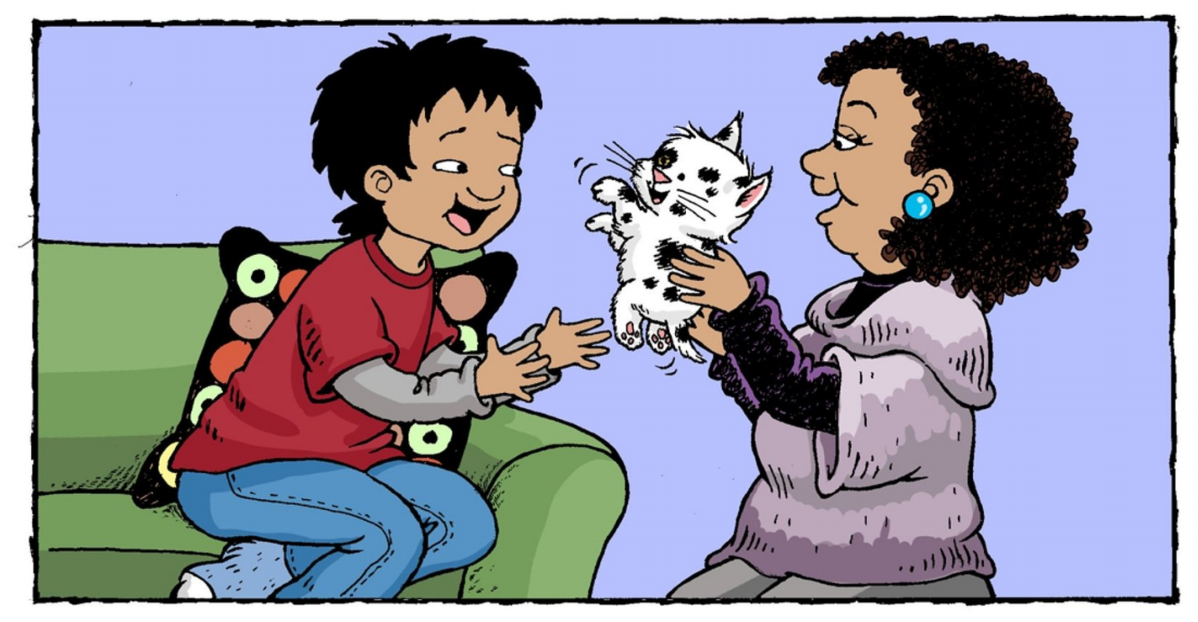
Carlos has one kitten.

Slide 3
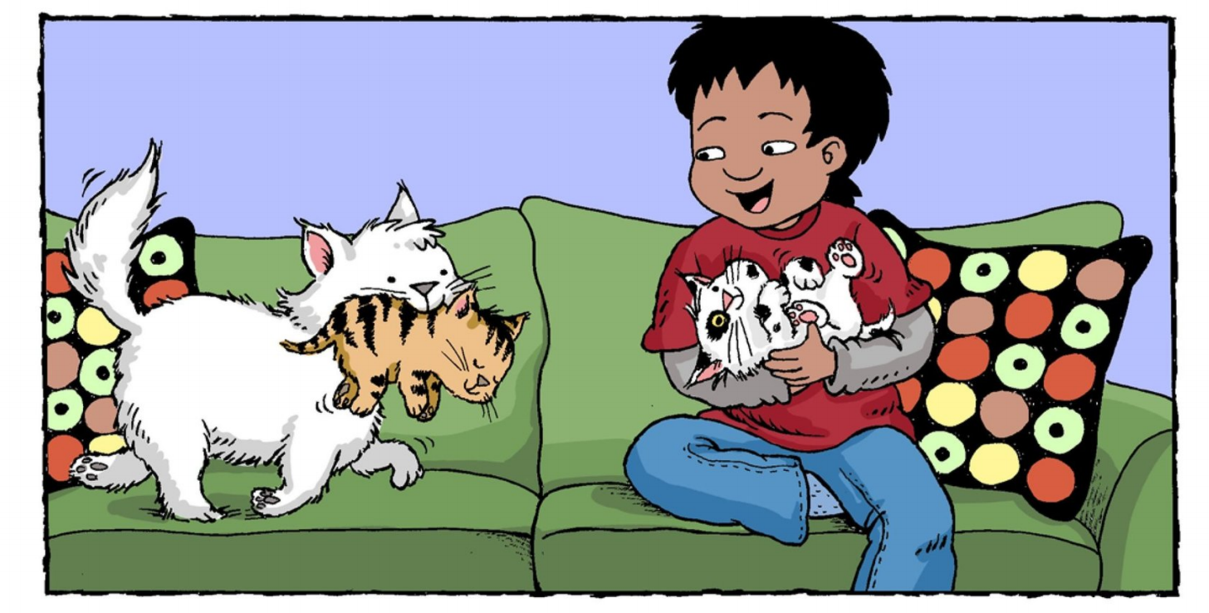
Carlos has two kittens.

Slide 4
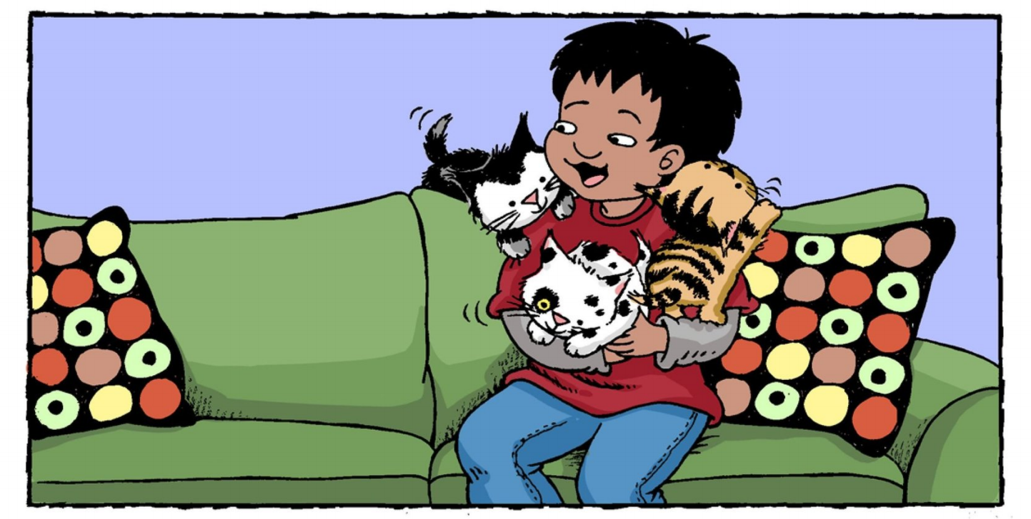
Carlos has three kittens.

Slide 5
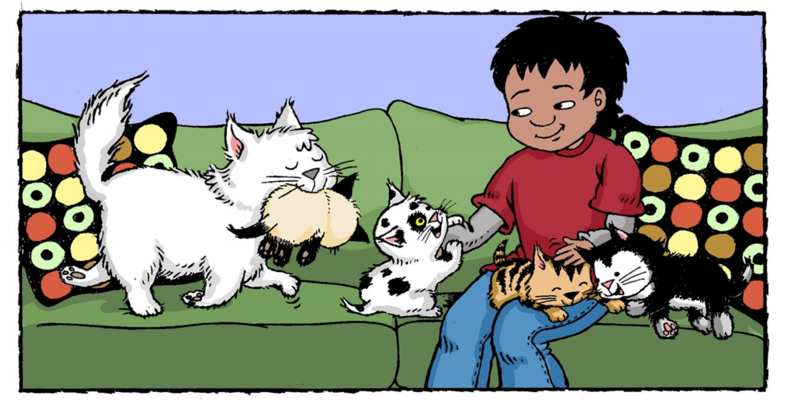
Carlos has four kittens.

Slide 6
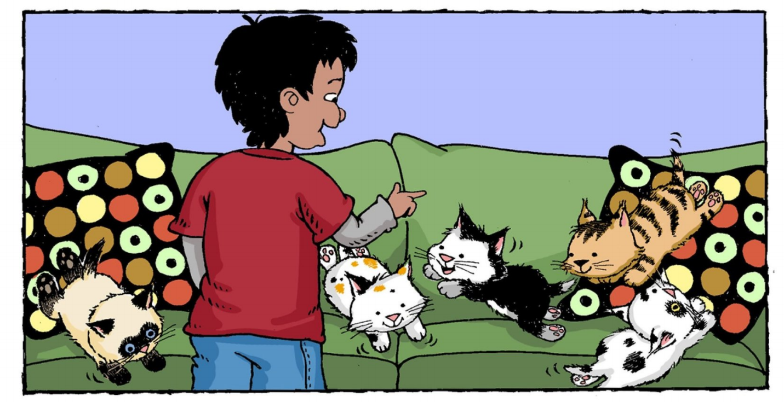
Carlos has five kittens.

Slide 7
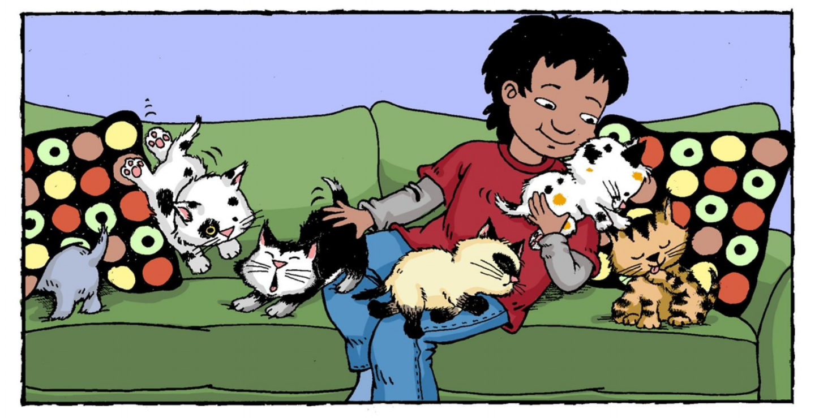
Carlos has six kittens.

Slide 8
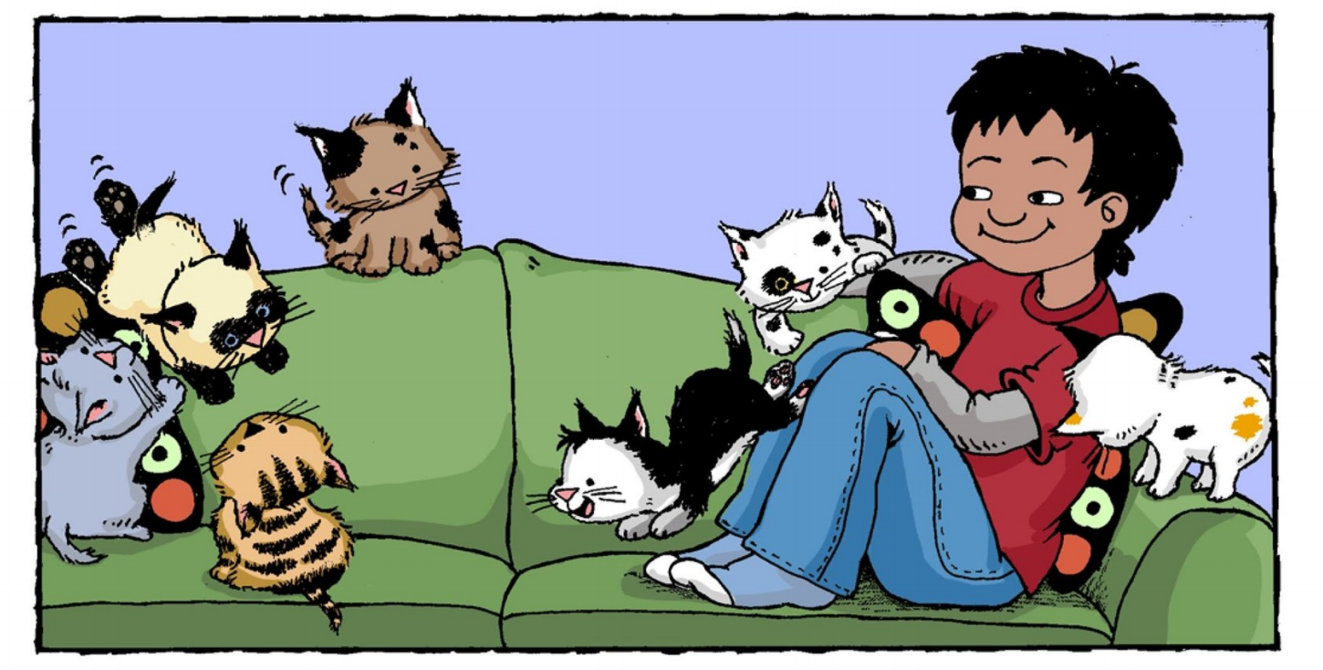
Carlos has seven kittens.

Slide 9
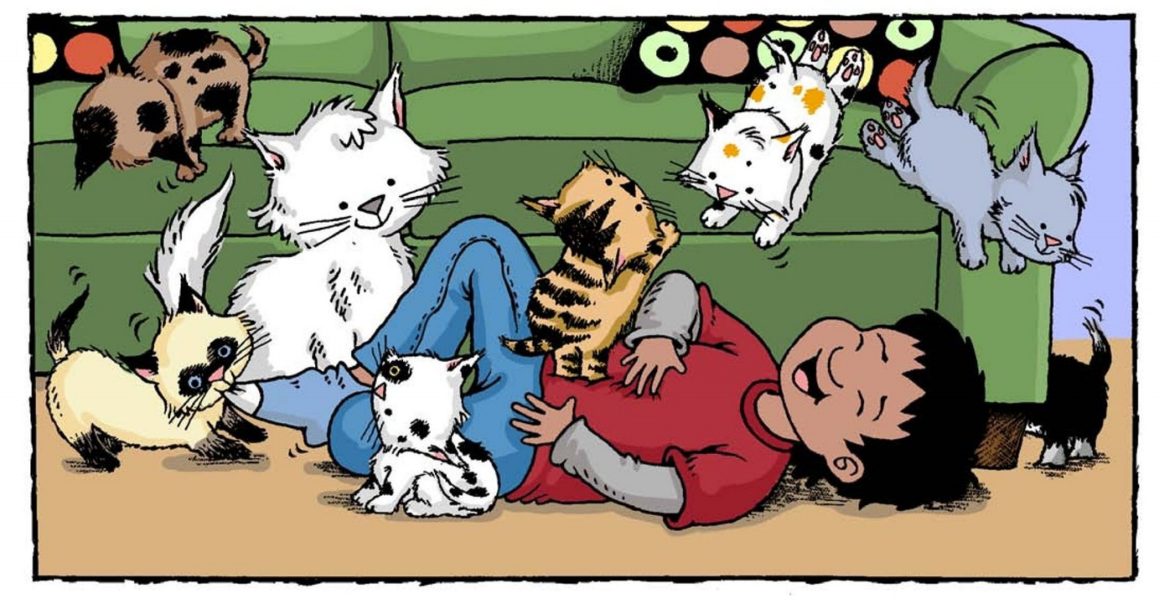
Carlos has too many kittens!

Slide 10
one
two
four
three
five
six
seven
Click on the colored buttons to start getting to know the numbers!

Slide 11
Carlos has one kitten.
Return

Slide 12
Carlos has two kittens.
Return

Slide 13
Carlos has three kittens.
Return

Slide 14
Carlos has four kittens.
Return

Slide 15
Carlos has five kittens.
Return

Slide 16
Carlos has six kittens.
Return

Slide 17
Carlos has seven kittens.
Return

